Slide 1
SSH
Setup

Slide 2
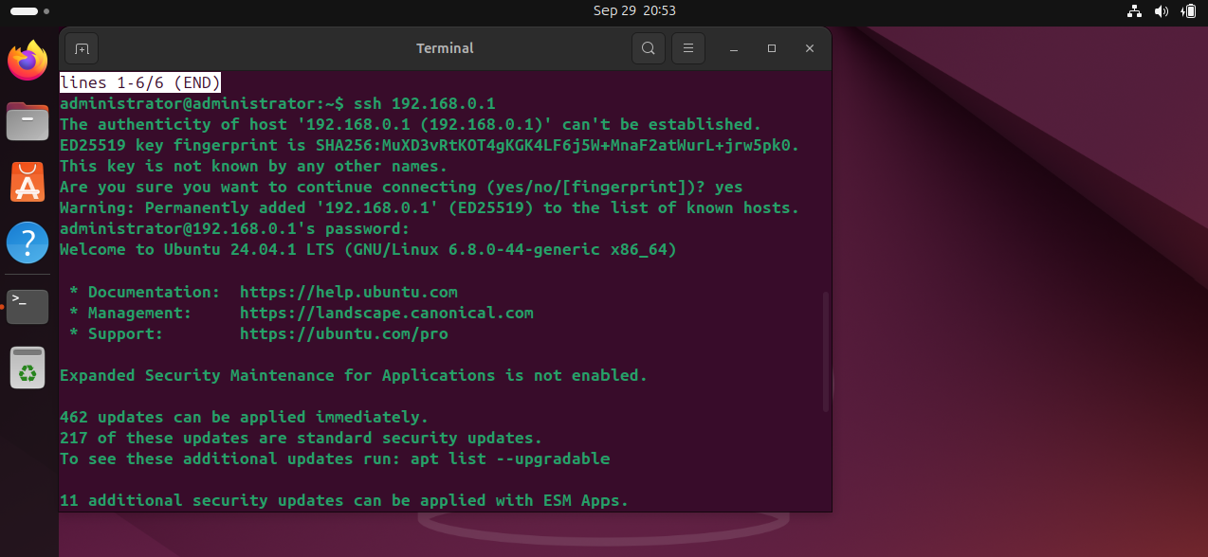
SSH connection to the server

Slide 3
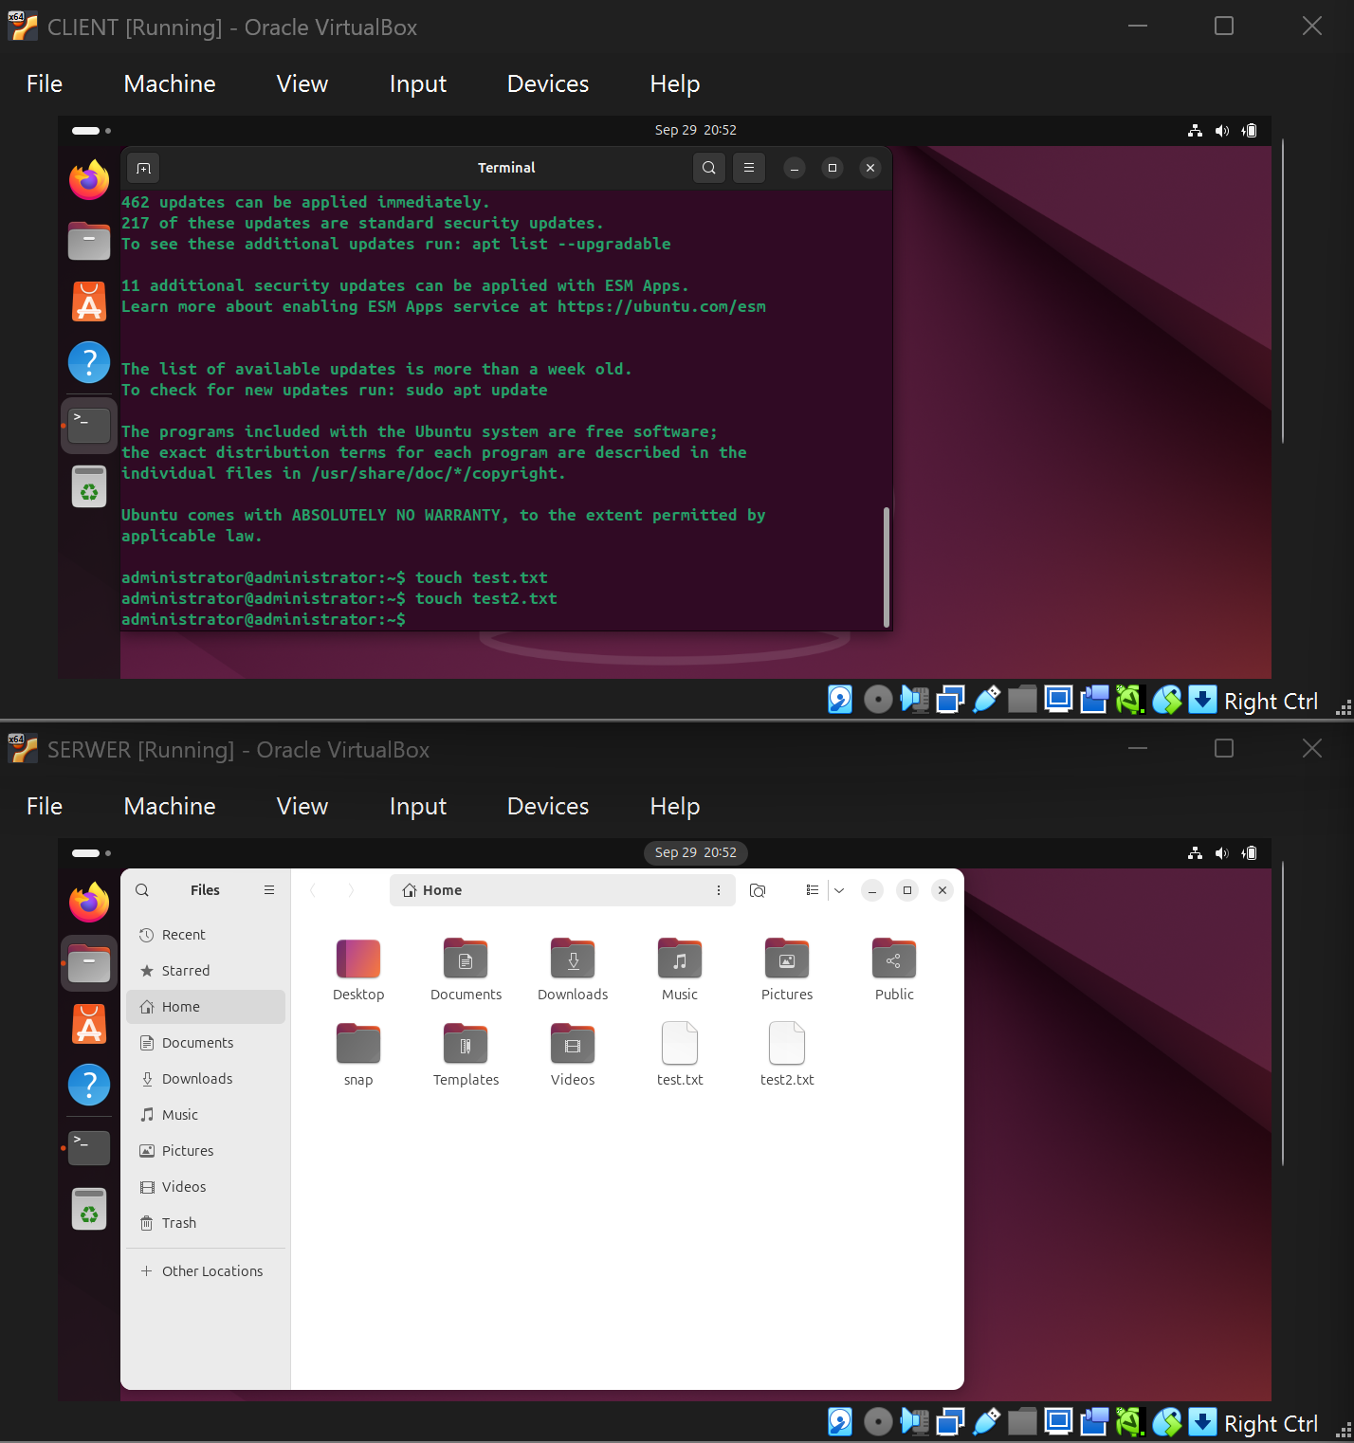
Creating test files with
SSH connection to the server

